Slide 1
Relationships Mix/Max Cardinalities

Slide 2
What is a relationship?
Association of two (or more) “things” (entities) in the real world.
Captures how entities interact and the constraints on that interaction.
Why do we care about that ?
It reflects the real world.
The mapping ratios (refined as min/max cardinalities) help capture and enforce business rules.

Slide 3
Objectives
Revisit the relationship concept
Revisit mapping ratios
Revisit min/max cardinalities from Crow’s Feet Notation
Introduce min/max cardinalities for Chen’s Notation
NOTE: You need to know the positioning of Mapping Ratios on a conceptual model
Min/max cardinalities are at a finer level of detail and are part of both the Chen’s Notation and Crow’s Feet notation.

Slide 4
Student Course (Revisited)
Mapping Ratios
Student
N
takes
M
Course
Read as: a student takes no courses or up to many courses. A course is taken by at least one student and could be taken by many students.
Min/max cardinalities
Student
(0,N)
takes
(1,N)
Course
grade
Here: representing the concept of a grade. It is a relationship attribute for a many-to-many relationship. Note: the min/max cardinalities are a finer level of detail than M:N.
Relationship attribute
Student
(0,N)
takes
(1,N)
Course

Slide 5

Course Enrollment Example
Task: Suppose you want to develop a database to keep track of students, the courses they take, and the professors who teach the courses.
Description: For each student, you will need to know their name and address, and, obviously, each student must be uniquely identified. For professors, you only need an id and their name because the rest of their information is stored elsewhere (e.g., in a human resources database). Each course must have a title and number of credit hours.
Instruction: Draw the entity-relationship model for this situation using the Chen notation. Use min/max cardinalities.

Slide 6
Example: Student and Courses
Student#
credit-hrs
name
Course#
address
title
Student
(1,N)
takes
(1,M)
Course
Emp#
(1,M)
teaches
name
(0,N)
Professor
Student: (Student#, name, address)
Course: (Course#, title, credit-hrs)
Professor: (Emp#, name)

Slide 7
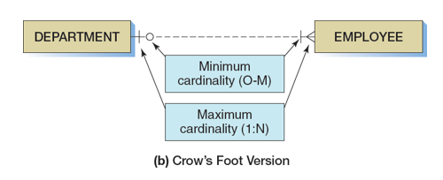
Crow’s Feet Note the contrast in the placement of min/max cardinalities.
Interpretation:
Each department has at least one employee, but can have many.
Each employee is optionally assigned to one department. This is represented by the ‘0’ (stands for optional) and a maximum of 1.

Slide 8
Summary
The relationship concept is important in conceptual modeling. It represents how things interact (are associated) with each other in the real world.
The representation of min/max cardinalities is different in the crow’s feet notation and Chen’s notation. Know both of these notations.
There are also different notations in the literature.
The most important thing is to understand the syntax and how it works while recognizing that the syntax differs depending upon the representation (Chen’s or Crow’s Feet) you use.
Be consistent in the use of notation (within a given problem).

